Slide 1
Welcome to our annual trainings.
Facilitator: Karen Wright, Master SPED, Behavior Analyst

Slide 2
HUMAN RIGHTS

Slide 3
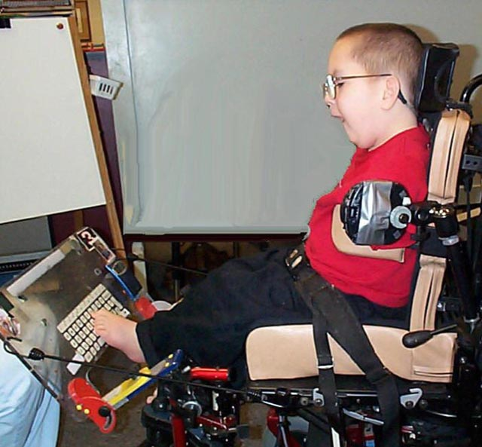
HUMAN RIGHTS

Slide 4
Human Rights
Individuals special needs still have rights just Iike all non-special needs individuals.

Slide 5
HUMAN RIGHTS
Right to exercise religious preferences.
Right to exercise political preferences.
Right to exercise sexual preferences.
Right to marry.
Right to choose own physician.

Slide 6
Human Rights
Guardianship
If the person has a guardian, the guardian is legally responsible making all decision for the person.
They agency must have a copy of the guardianship papers on file.

Slide 7
Fire Safety

Slide 8
FIRE SAFETY
Ensure the home is equipped with working smoke detectors.

Slide 9
FIRE SAFETY

Slide 10
FIRE EXTINGUISHERS

Slide 11
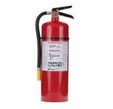
FIRE SAFETY
Check the fire extinguishers monthly.

Slide 12
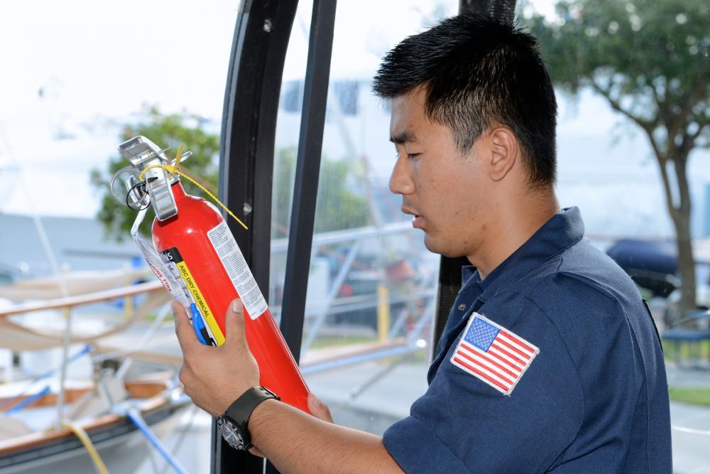
Fire Safety
The monthly checks should be documented. Also, the fire extinguisher should be inspected and certified annually by a fire protection equipment company.

Slide 13
FIRE SAFETY
In the event of a fire, sound the alarm for everyone to evacuate.

Slide 14
Fire Safety-Have everyone evacuate.

Slide 15
Fire Safety
Once outside do a head count and make sure everyone is outside.

Slide 16
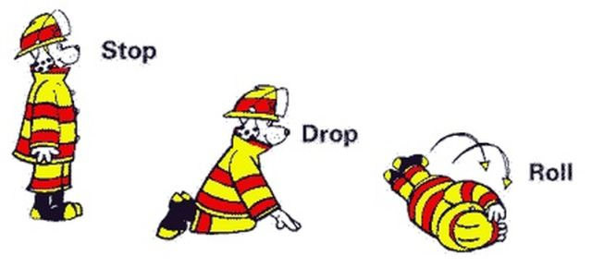
Fire Safety
If someone is on fire, do a:

Slide 17
Fire Safety
If the fire is manageable, then quickly grab an extinguisher and

Slide 18
Fire Safety
Yell to the able bodied people to get out.

Slide 19
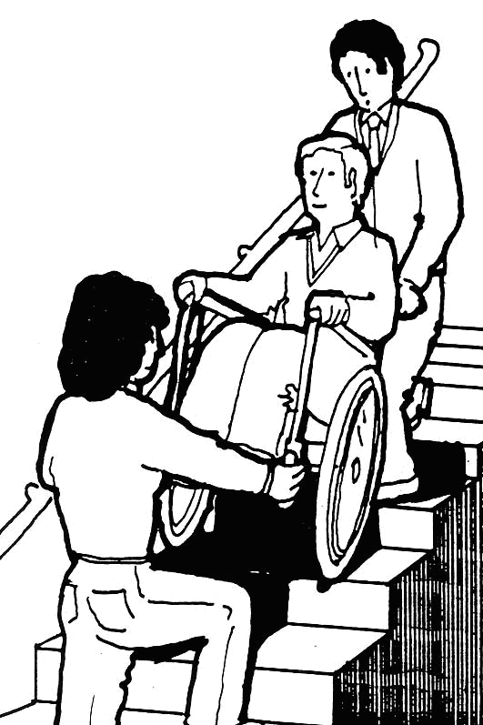
Fire Safety
Assist those who need help to evacuate.

